Slide 1

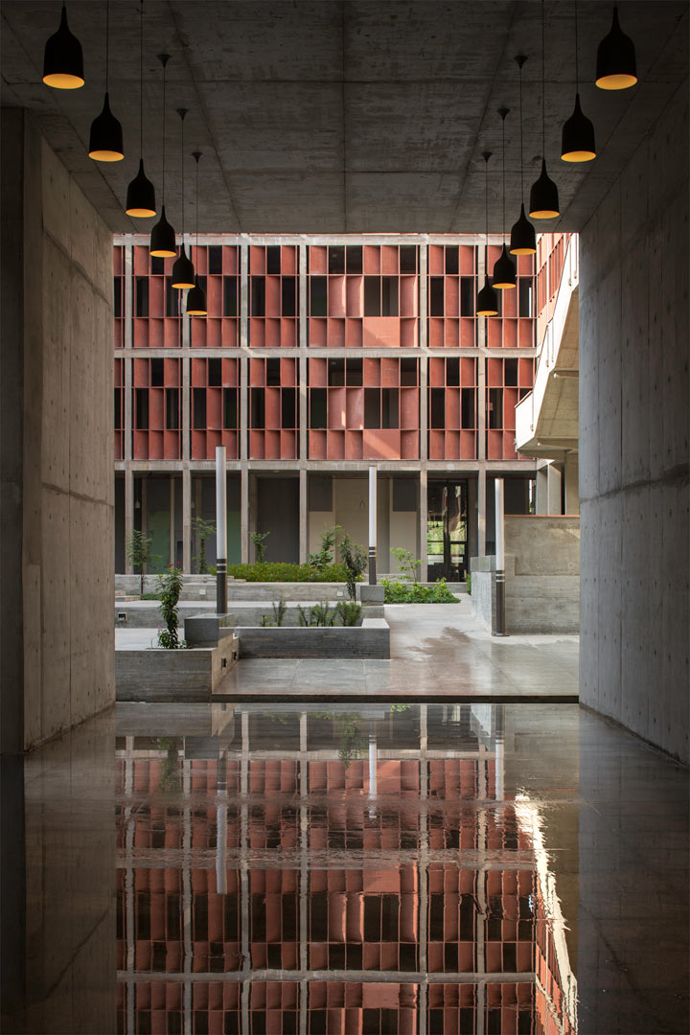
Event Details
Important Dates
Apply Before:10th Aug,2017
Commencement of Course: 16th August,2017
Invited Speakers
Prof. Dr. Dhaval Patel
Prof. Dr. Miguel Lopez
Prof. Dr. Mehul Raval
Prof. Dr. Yogesh N Trivedi
Prof. Dr. S.N Merchant
Enrollment Fees
For Faculties: 3500 INR
PG/Ph.D Students:2500 INR
Industry People: 4000 INR
Enrollment Fees are non-refundable The course materials will be provided to all the registered participants.
Fees can be paid by Demand Draft/Local cheque, drawn in favour of “Ahmedabad University” payable at Ahmedabad.
Program Committee
Dr. Dhaval Patel, Convener
Dr. Srikrishnan Divakaran
Dr. Ratnik Gandhi
Organizes
A Faculty development Program on
“Advanced Wireless Communication Using USRP/GNU Radio”
August 16-20,2017
As a Part of DST-UKIERI Project
Organizing Committee
Prof. Sanjay Chaudhary, Convener
Dr. Dhaval Patel
Dr. Mazad Zaveri
Mr. Anurag Lakhlani
Mr. Pratik Trivedi
For further details, please contact:
Brijesh Soni (JRF)
213,Communication lab,SEAS Ahmedabad University.
M: 8905409657
Email: sonibrijesh92@gmail.combrijesh92@gmail.co
Website:

Slide 2
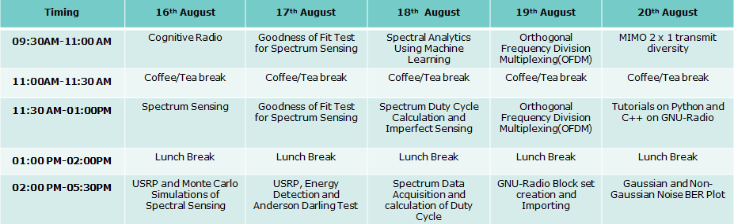
Program Overview
The Program includes cognitive radio (CR), Spectrum sensing techniques like energy detection and improved energy detection, Imperfect Spectrum sensing, Spectrum analytics Using Machine learning and OFDM followed by three hours of respective lab session on USRP and GNU Radio to further enhance and consolidate understanding of the participant.
School of Engineering and Applied Science
AHMEDABAD UNIVERSITY
APPLICATION FORM
Faculty Development Program on
“Advanced Wireless Communication Using USRP/GNU Radio”
August 16-20,2017
1. Name Mr/Ms…………………..............
2. Designation………………………………….
3. Organization………………………………..
4. Contact………………………………………..
5. Email…………………………………………..
6. Experience in relevant area
Academic…………………………………….
Industry………………………………………
7. Cheque/D.D No……….........................
Dated……………….…Bank…………………
8. Accommodation required (YES/NO)
Date:
Signature of Participant:
Objective Of The Program
The programm intends to equip participants with following objectives:
1. Knowledge of USRP and GnuRadio
2. Lecture on Cognitive Radio
3. Imperfect spectrum sensing , spectrum analytics
4. OFDM followed by 3 hours of lab session
For Whom?
This Faculty Development Program is especially intended to provide faculty members of engineering colleges, Research scholars in wireless communication, Post-graduate students, Engineers and a few interested undergraduate students with good academic record, who would like to further explore the latest research in current wireless systems, can also be a part of this program.

Slide 3
Timing | 16th August | 17th August | 18th August | 19th August | 20th August
09:30AM-11:00 AM | Cognitive Radio | Goodness of Fit Test for Spectrum Sensing | Spectral Analytics Using Machine Learning | Orthogonal Frequency Division Multiplexing(OFDM) | MIMO 2 x 1 transmit diversity
11:00AM-11:30 AM | Coffee/Tea break | Coffee/Tea break | Coffee/Tea break | Coffee/Tea break | Coffee/Tea break
11:30 AM-01:00PM | Spectrum Sensing | Goodness of Fit Test for Spectrum Sensing | Spectrum Duty Cycle Calculation and Imperfect Sensing | Orthogonal Frequency Division Multiplexing(OFDM) | Tutorials on Python and C++ on GNU-Radio
01:00 PM-02:00PM | Lunch Break | Lunch Break | Lunch Break | Lunch Break | Lunch Break
02:00 PM-05:30PM | USRP and Monte Carlo Simulations of Spectral Sensing | USRP, Energy Detection and Anderson Darling Test | Spectrum Data Acquisition and calculation of Duty Cycle | GNU-Radio Block set creation and Importing | Gaussian and Non-Gaussian Noise BER Plot

